Slide 1
FoodStreet Website
Presented by:
Mayank Upadhyaya,
Priyanshi,
Vishal Dixit

Slide 2
Supervised by:
Mr. Mandeep Singh
Technical Trainer
Training and Development Department
GLA University , Mathura

Slide 3
outline
Introduction
Features
User Experience
Technology
Snapshots from website
Conclusion

Slide 4
Introduction
FoodStreet is a website that has been created using the latest HTML, CSS and JavaScript technologies. This website is designed to provide users with a wide range of food options from different cities around the world.
FoodStreet has been designed with the aim of providing users with an easy-to-use platform that allows them to explore different cuisines from different parts of the world. With its user-friendly interface and extensive collection of food options.
FoodStreet is quickly becoming one of the most popular food websites on the internet.

Slide 5
Features
One of the key features of FoodStreet is its extensive collection of food options. Users can browse through a variety of cuisines from different cities around the world, including traditional dishes and modern fusion creations.
In addition to its vast selection of food options, FoodStreet also offers a number of other features that make it stand out from other food websites. These include ratings, discount offers , add to cart option available to add multiple food items at time and the ability to save favorite dishes for future reference.

Slide 6
User Experience
FoodStreet has been designed with the user experience in mind. The website is easy to navigate , with clear menus and search functions that allow users to find exactly what they are looking for.
In addition , FoodStreet’user interface is visually appealing, with high-quality images of each dish and detailed descriptions that provide information about the ingredients and cooking methods used. This attention to detail ensures that users have a satisfying and informative experience when browsing the website.

Slide 7
Technology
The FoodStreet website was built using a combination of HTML , CSS , JavaScript and Firebase . These technologies were chosen for their versatility , reusability , and compatibility with modern web browsers.
The website also utilizes responsive design techniques, allowing it to adapt to different screen sizes and resolutions. This ensures that the website is accessible and usable on a wide range of devices , from desktop computers to mobile phones.

Slide 8
This is how our website looks
Hope you will like it ☺

Slide 9
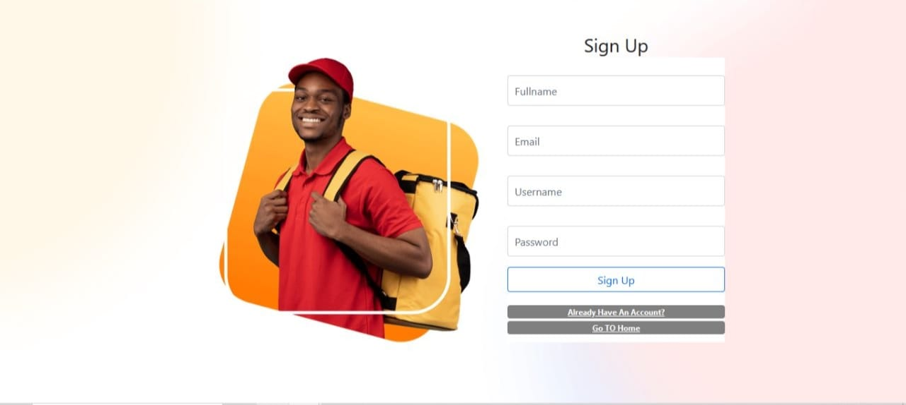

Slide 10
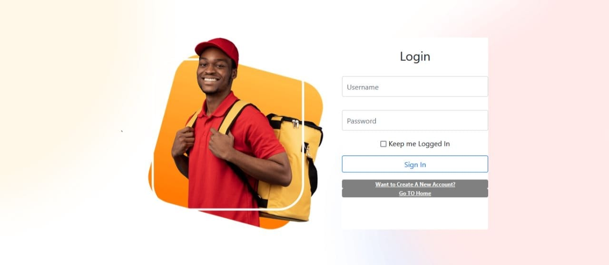

Slide 11
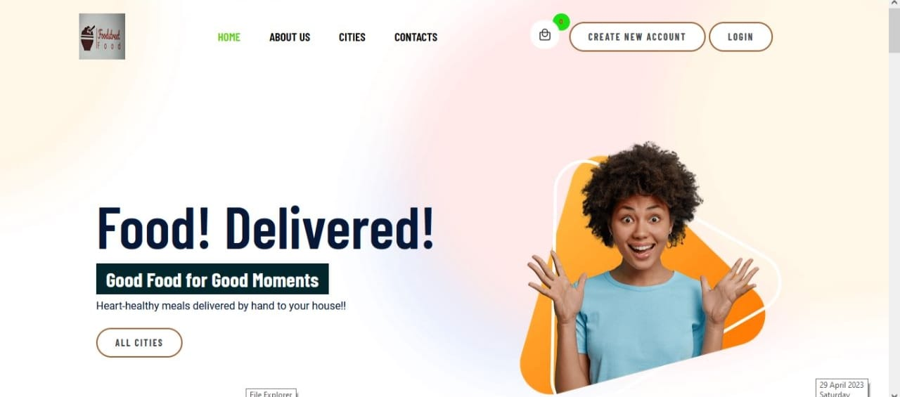

Slide 12
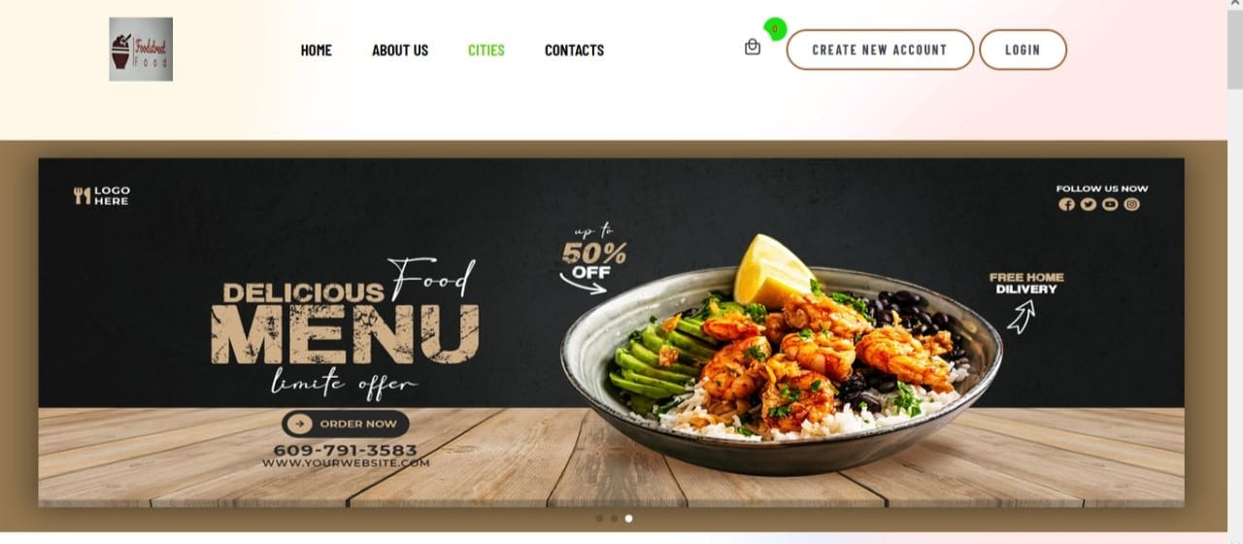

Slide 13
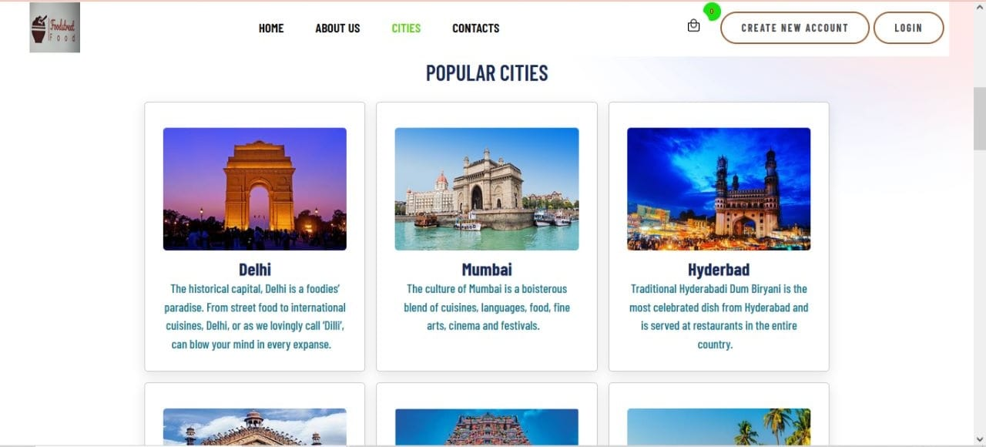

Slide 14
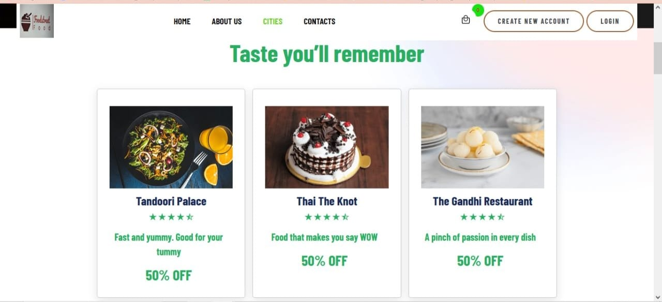

Slide 15
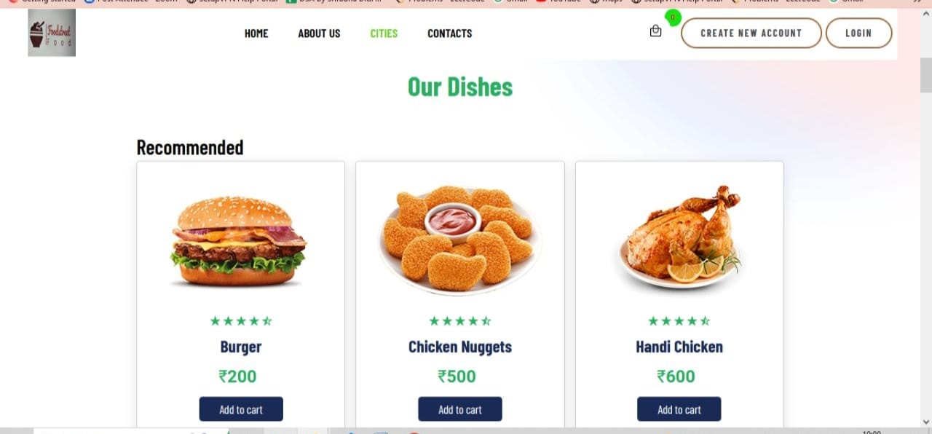

Slide 16
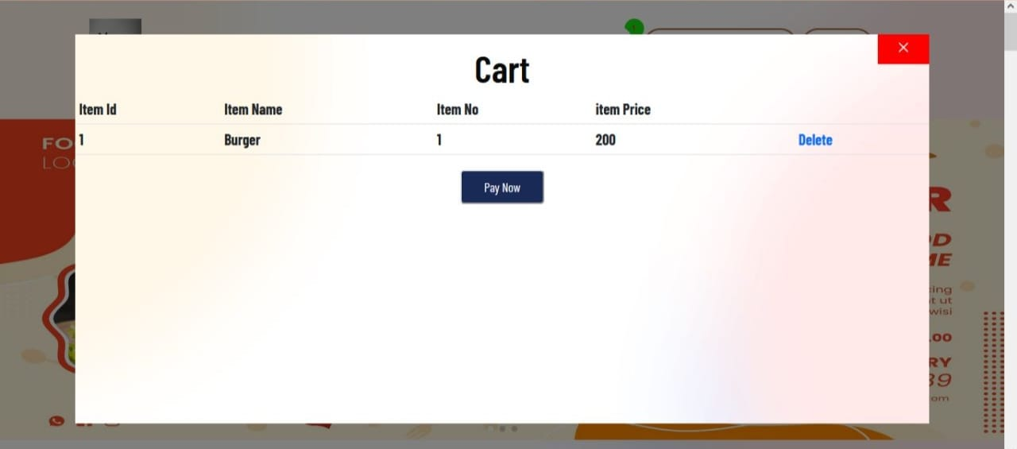

Slide 17
Conclusion
In conclusion ,FoodStreet is a website that has been designed to provide users with a comprehensive and enjoyable food experience. With its extensive collections of food options , user-friendly interface.
Whether you are looking for traditional dishes from your hometown or want to explore new and exciting flavors from around the world, FoodStreet has something for everyone. So why not join the FoodStreet today and start exploring the amazing world of global cuisines?

Slide 18
Thank You !!!!

